Slide 1




Rural Enterprise Development & Support

Slide 2

What we offer
  Community-based client focussed enterprise support for anyone who wants to develop an idea or start a business (or social enterprise)
  Provides individuals and small organisations/companies with flexible enterprise advice, guidance and connections
  Services are free and confidential
  ‘Empathetic and efficient’!
GrowBiz Enterprise Support
One to One Support
Peer Support Meetings
Womens Enterprise Network
Learning sessions
GrowBiz XChange
GrowBiz Enterprise
Mentoring Support

Slide 3
What we believe
  If you capture the energy and
  aspirations of individuals to improve their lives - and those of their communities - and results will follow.............
  Ernesto Sirolli

Slide 4

Partnership Work
Enterprising Rural Perthshire
Perthshire Chamber of Commerce
Elevator
Business Gateway
Perth and Kinross Association of Voluntary Services
Other Partners
Blairgowrie High School
Strathmore Centre for Youth Development
The Social Enterprise Academy
The Care and Wellbeing Co-operative

Slide 5
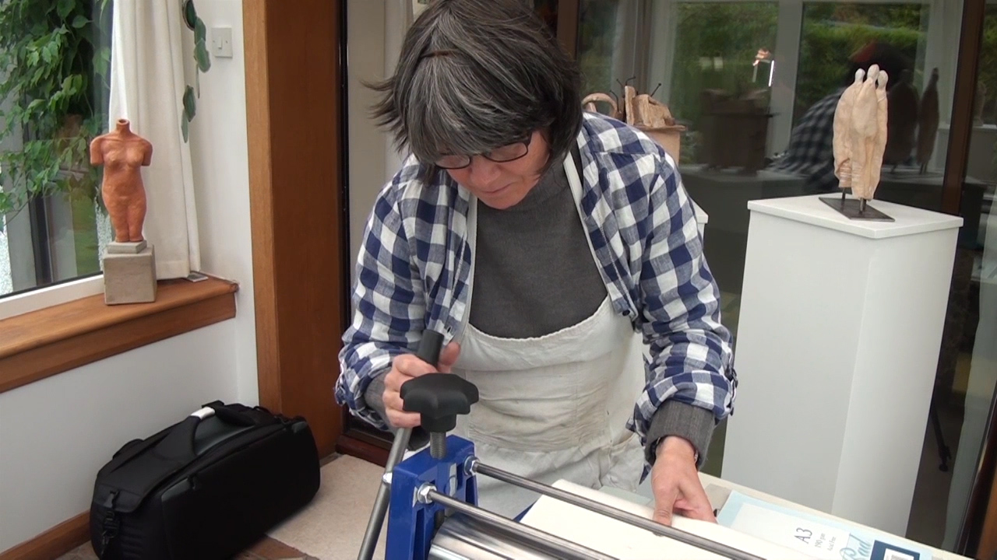
GrowBiz businesses look like this.......
Notes:
5

Slide 6
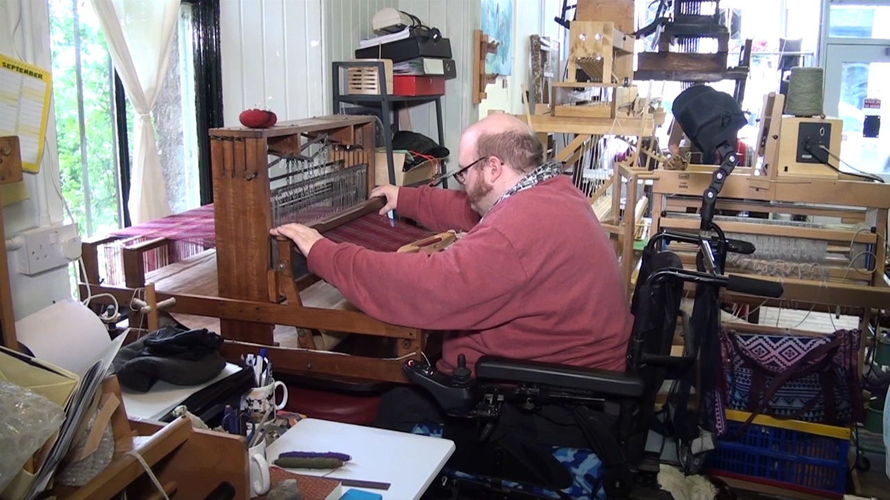
and this.................
Notes:
6

Slide 7
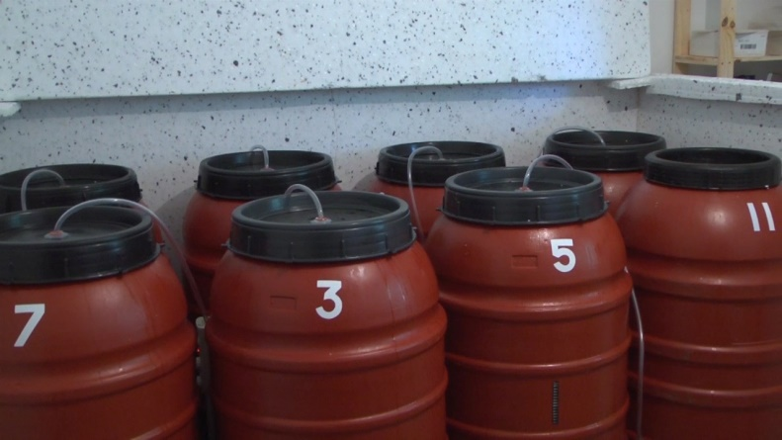
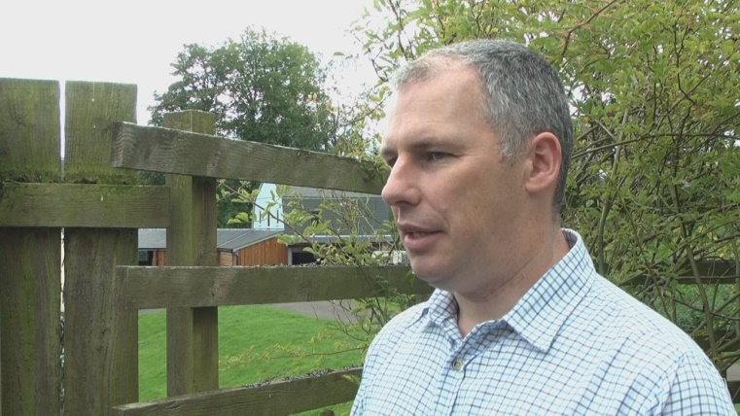
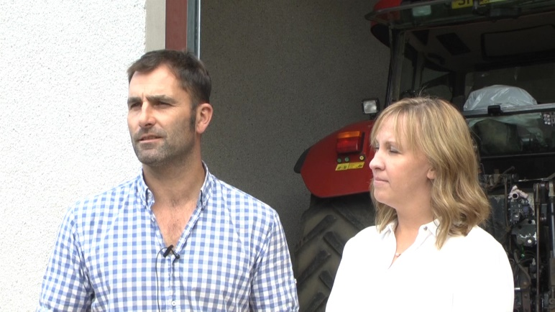
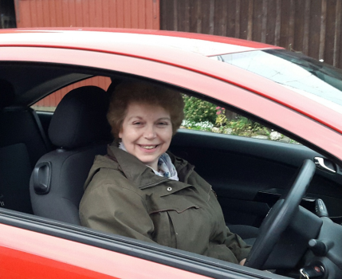
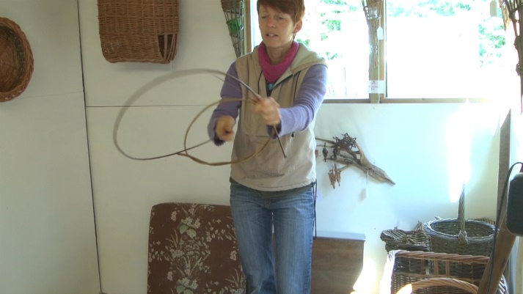
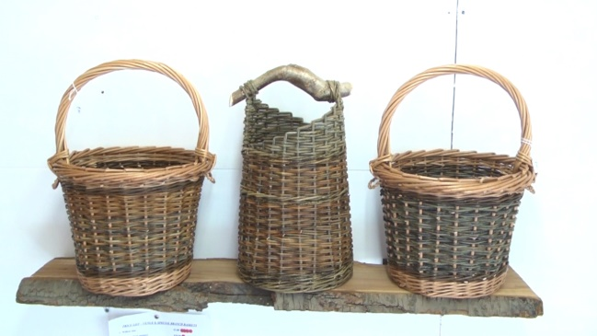
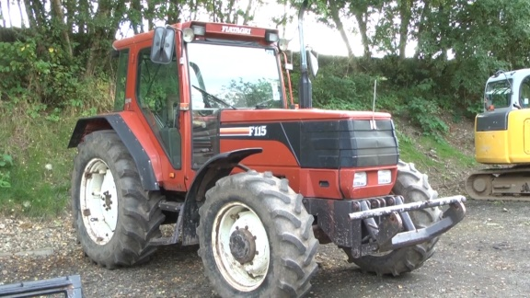
and these...............
Notes:
7

Slide 8
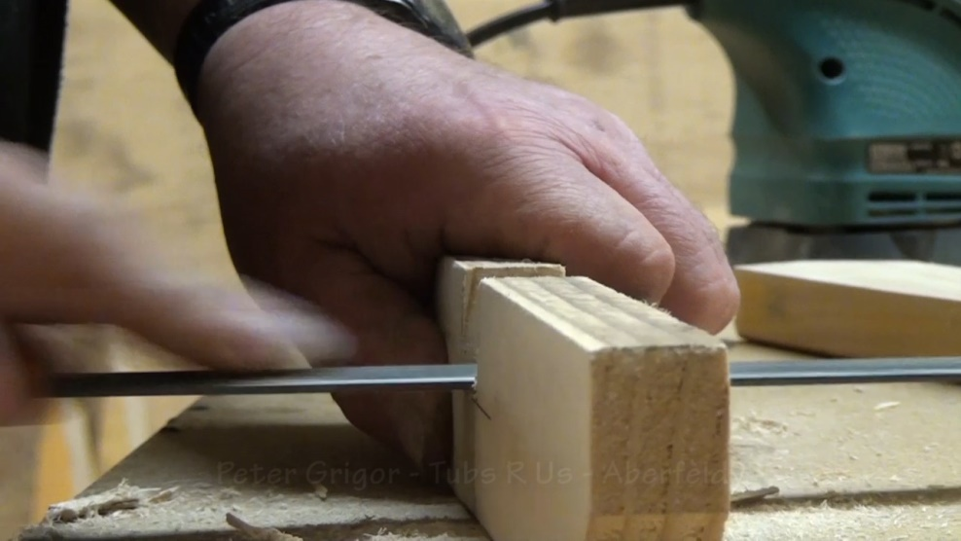


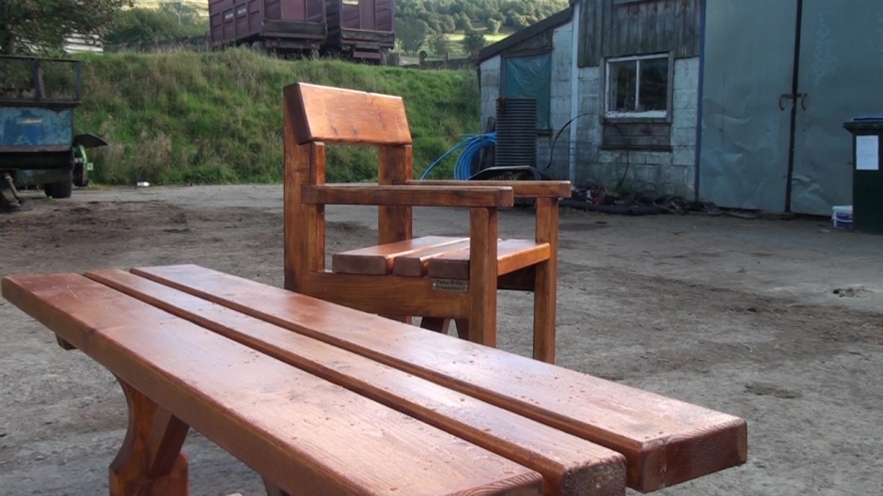
and many more.......................
Notes:
8

Slide 9
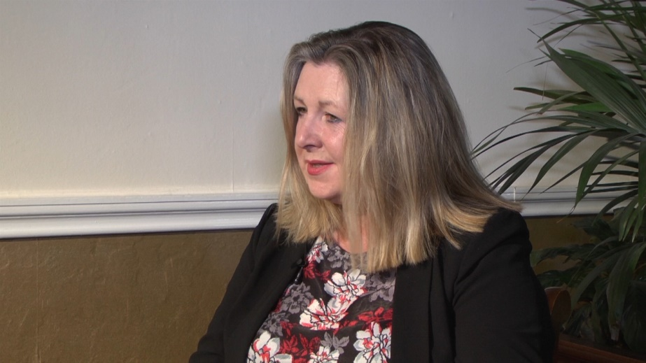

One to One Support

Slide 10
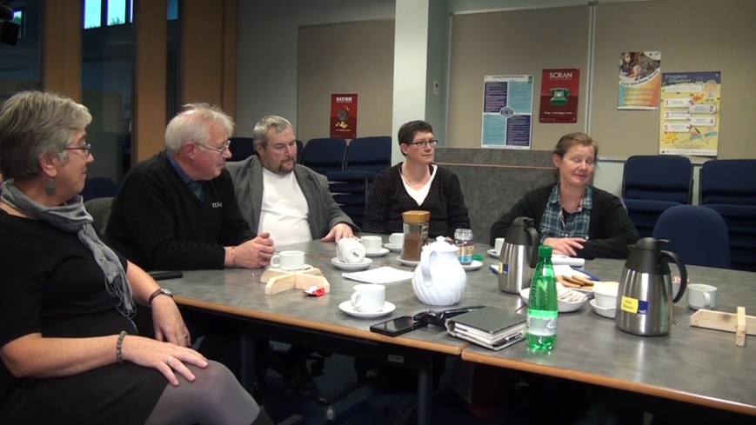
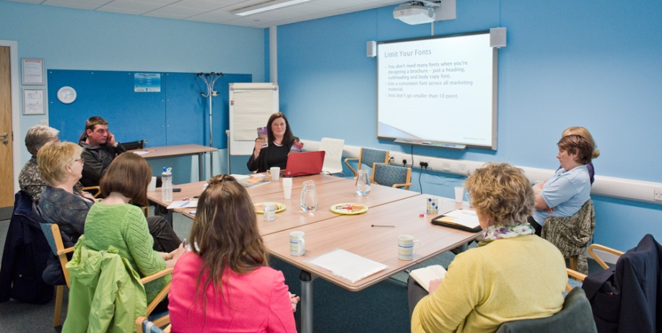
Peer Support and Learning

Slide 11
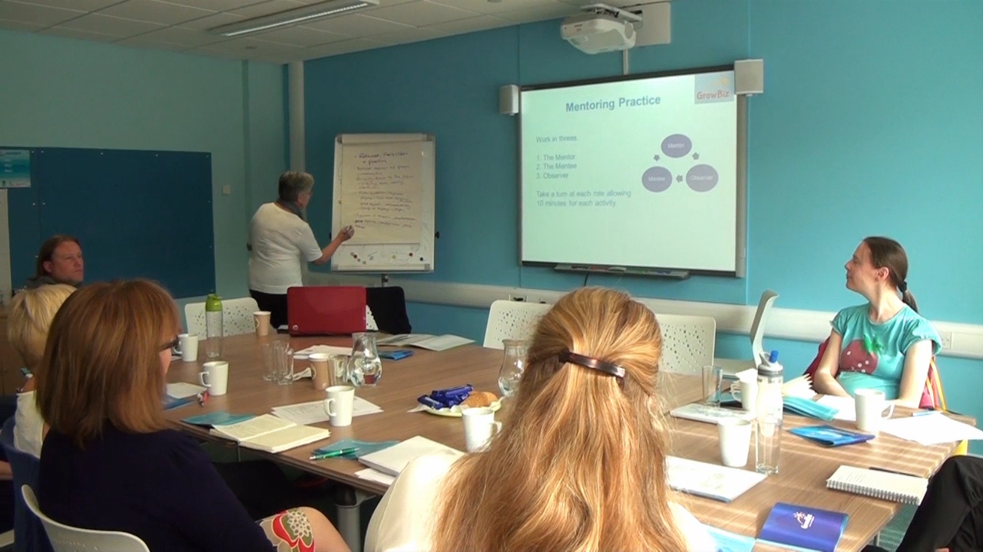
Mentoring

Slide 12

Women’s Enterprise Network

Slide 13
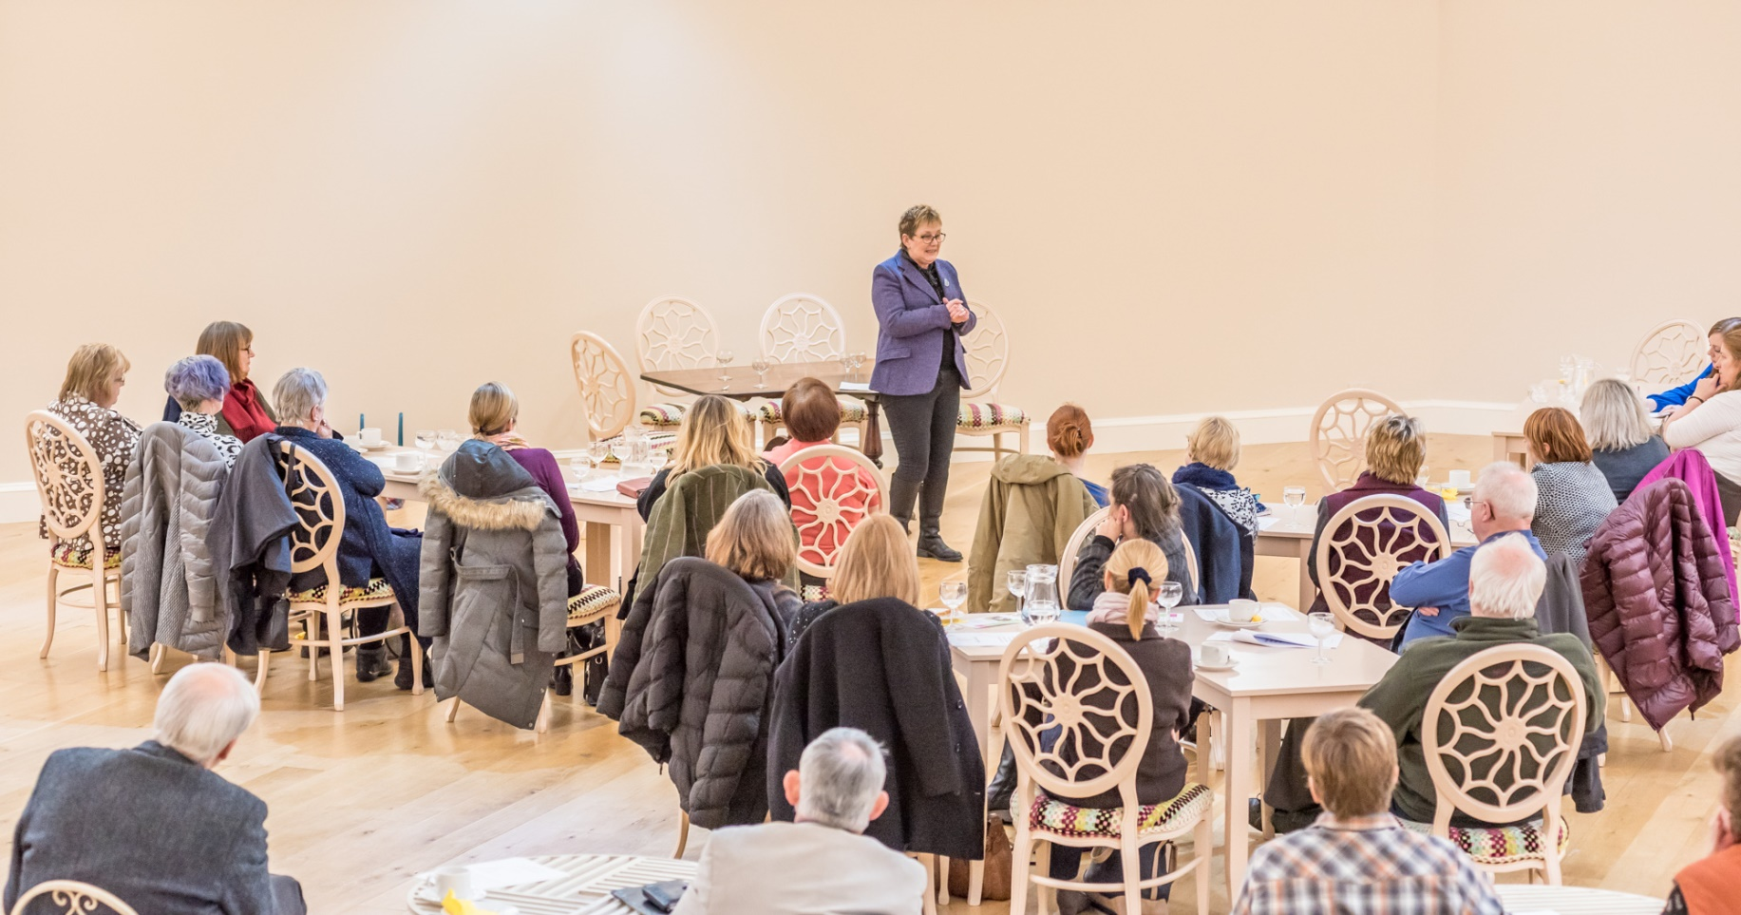
GrowBiz XChange

Slide 14
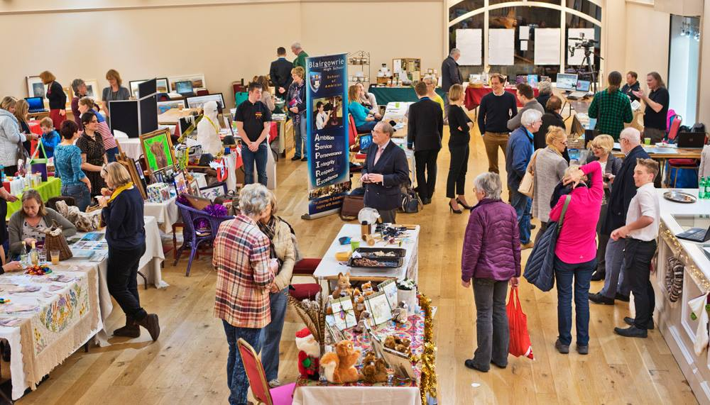
Enterprise Showcase

Slide 15

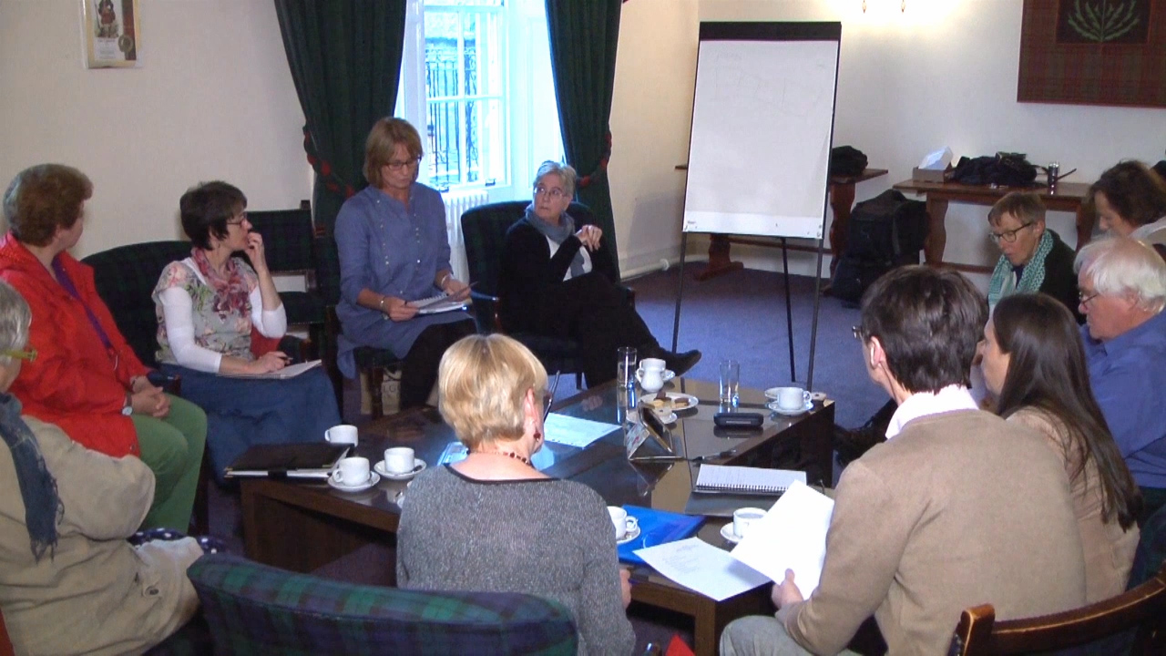

Slide 16
Contact: Jackie Brierton
Coordinator@growbiz.co.uk
www.growbiz.co.uk
@grow_biz

